Slide 1
The BENEFITS OF PLAYING A MUSICAL INTSTRUMENT
Jp Lawrence

Slide 2

Agenda
Introduction
Study one (benefits)
Personal experience
Conclusion

Slide 3

Music
“A definition of music endeavors to give an accurate and concise explanation of music's basic attributes or essential nature and it involves a process of defining what is meant by the term music. Many authorities have suggested definitions, but defining music turns out to be more difficult than might first be imagined, and there is ongoing debate. A number of explanations start with the notion of music as organized sound, but they also highlight that this is perhaps too broad a definition and cite examples of organized sound that are not defined as music, such as human speech and sounds found in both natural and industrial environments .^{[1]} The problem of defining music is further complicated by the influence of culture in music cognition.”

Slide 4
STUDY one
To investigate, the researchers recruited eight participants having a wide range of musical experience for participation in the study. The participants were aged 19-24 and provided 10 pieces of instrumental music they found pleasurable

Slide 5
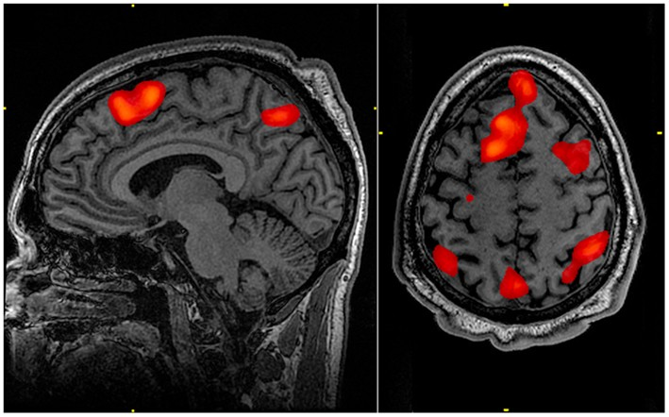
fMRI Image Capture

Slide 6
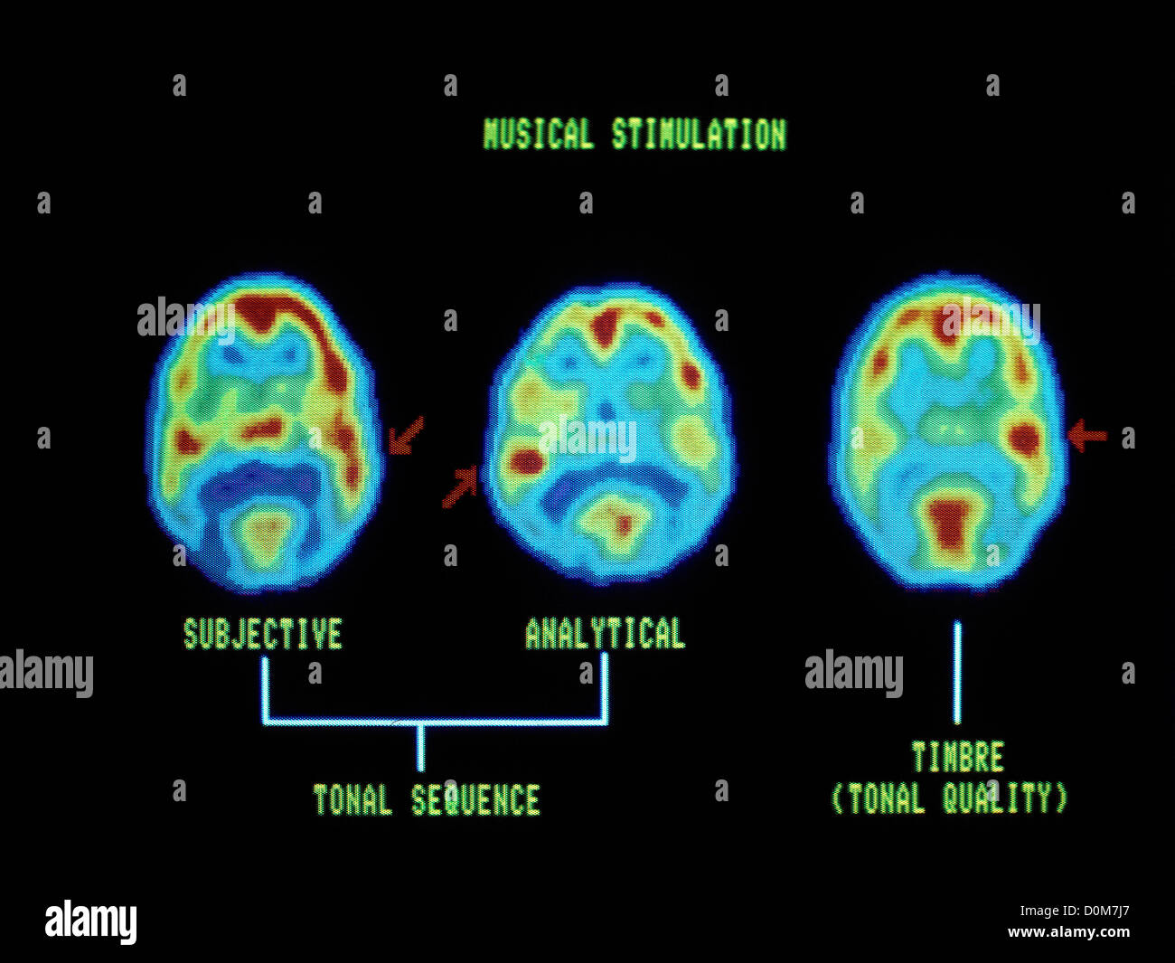
PET Image Capture

Slide 7
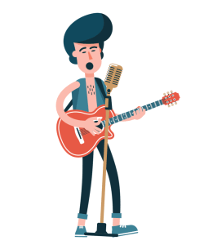
Musicians who begin their training around 7 years old have a significantly larger corpus callosum than others without the same training. That means that the two halves of musicians’ brains can communicate with one another more quickly and along more diverse routes across their expanded corpus callosum. As a result, musicians are more likely to be inventive problem-solvers.
Source: HERE

Slide 8



Summary
Music is a beautiful form of expression. It is that form of art that evolves continuously.
Not only is it mesmerizing, but it also has extreme benefits to one’s physical and mental health.
LEARN TO PLAY AN INSTRUMENT!

Slide 9




Thank you
Jp Lawrence
English Oral

